Slide 1

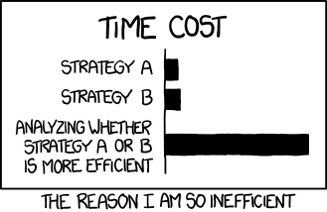
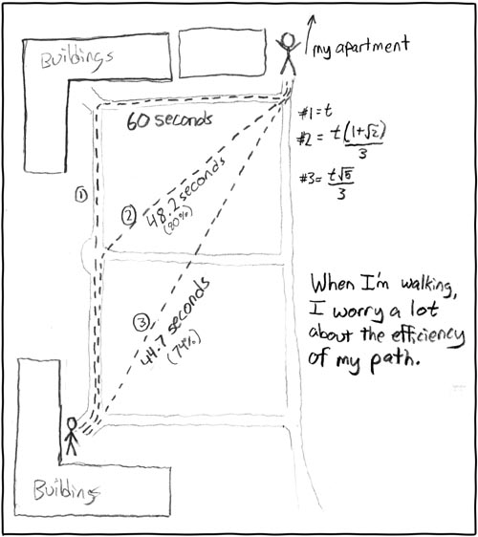
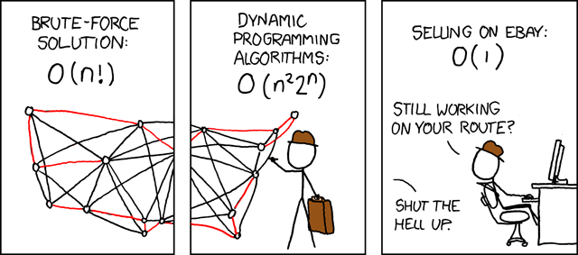
https://xkcd.com/1445/
https://xkcd.com/399/
https://xkcd.com/85/

Slide 2

Path Planning using Parallel Computing
Aaron John Sabu
Athul C D
Ayan Sharma
Vaibhav Malviya
High Performance Scientific Computing (ME 766) Prof Shivasubramanian Gopalakrishnan Spring 2021
Notes:
VAIBHAV
Good evening, Professor Gopalakrishnan and my dear friends.
Since childhood we have been using direction software like Google Maps for routing from one place to another. But how do these work?
Our team took motivation from this problem and implement some famous roadmap-based path planning algorithms. We implement the concepts that we’ve learned from this course on high performance scientific computing and demonstrate how parallel computing can make operations run way faster than they usually are.

Slide 3
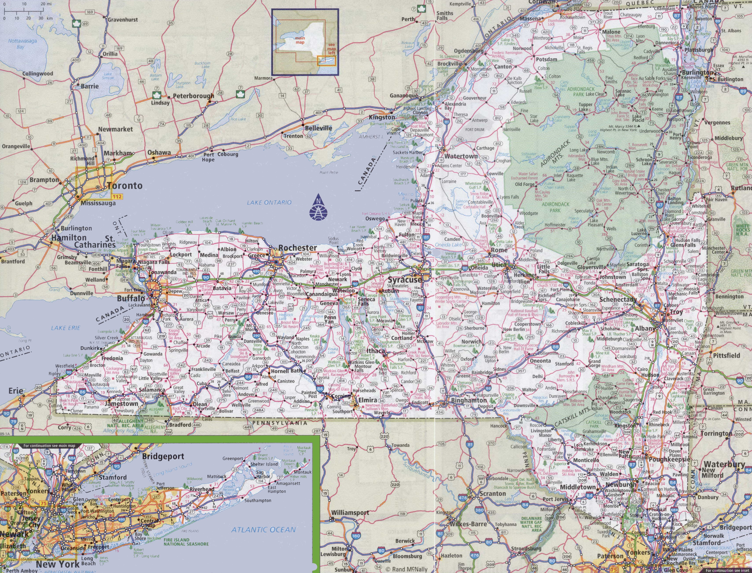
Our Goals
01
Implement path planning techniques for a roadmap-based problem from one point (node) to another using algorithms such as Dijkstra’s algorithm, Bellman-Ford algorithm, and Floyd-Warshall algorithm
New York State Roadmap...
02
Incorporate shared memory parallel computing elements into the program using the implementation of OpenMP at suitable locations
03
Compare the performance of the algorithms with each other along with their respective implementations on OpenMP and CUDA
264346 nodes 733846 edges
a <start> <end> <distance>
Notes:
VAIBHAV
Coming to our goals.
At first, we implemented 3 major path planning techniques such as Dijkstra’s algorithm, Bellman-Ford algorithm, and Floyd-Warshall algorithm.
Next, we incorporated features of the OpenMP parallel computing platform to speed up our algorithms by multiple magnitudes.
And finally, we compared with their respective implementations in OpenMP and CUDA.
Next for the dataset, we used the real time road map of New York City.
Its size of this database with more than 200,000 nodes and more than 700,000 edges. Furthermore, a real world data set helps to see how the algorithms work in real life situations.
The database contains information pertaining to each start node, end node identifier, and the distance between the two points.
We also used smaller randomly generated graphs to run our algorithms for basic testing. We’ll see more about this later.

Slide 4

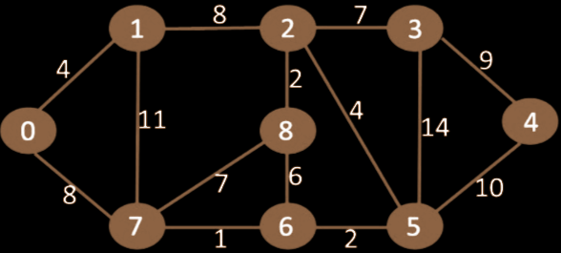
The Serial Algorithms
Dijkstra’s Algorithm
Bellman-Ford Algorithm
Floyd-Warshall Algorithm
Greedy Algorithm
Select node with min distance and relax the connected edges
Relaxes all the edges V-1 times
Check for negative weight cycles in the end
Dynamic programming
Shortest path in a directed weighted graph with positive or negative edge weights
Notes:
AYAN Dijkstra’s algorithm is a greedy algorithm which works only on graphs with positive weights of edges. The core step of algorithm after initializing the graph is to select node with minimum distance and check whether the distance between the neighbouring connected nodes can be minimized by relaxation. This step is executed until distances to all nodes have been minimized.
ATHUL
This is less optimized compared to Dijkstra’s algorithm. All the edges are relaxed V-1 times. The notion of "relaxation" is that the cost of the shortest path is an overestimate at every step. As shorter paths are found, the estimated cost is lowered. Eventually, the shortest path, if one exists, is found and all the distances are their optimal values. Once the relaxation process completed, a check for negative cycles is performed. AARON
The Floyd-Warshall algorithm is an example of dynamic programming and is formulated as three nested for-loops. It helps find the shortest paths in a directed weighted graph with positive or negative edge weights but with no negative cycles.

Slide 5


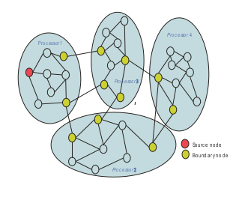
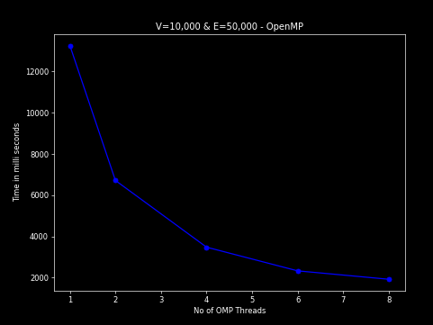
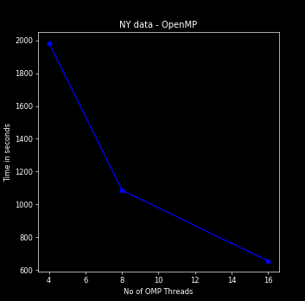
Dijkstra’s Algorithm
Algorithm 01
A very efficient serial implementation (using C++’s STL) of the algorithm just takes 3s to run on entire NY dataset.
We developed a parallelizable implementation of the algorithm by distributing vertices to different threads of OpenMP.
Speed up: 1.97, 3.81, 5.68, 6.89 for 2, 4, 6, 8 threads
Parallel algorithm on NY dataset with 4, 8, and 16 threads took 1984, 1086, and 653.8sec respectively.
Complexity: O((V+E)logV)
Notes:
AYAN
One of the most efficient SSSP algorithm with complexity O((V+E)logV).
This complexity is achieved when we use some efficient data structures like a minimum priority queue implemented with a fibonacci heap. We implemented the best possible serial implementations with STL data structures.
While parallelizing with openmp we realized many of these efficient STL data structures are not compatible with openmp. Hence we had to make customized data structures on our own but with those the parallelizable components of the serial algorithm reduced to negligible.
Finally, to demonstrate parallelization we took inspiration from a paper which used graph partitioning for parallelization. Graph partitioning in itself would have been a difficult problem to solve hence we used a naive approach in which we divided vertices for different threads without considering the topology of the graph. This method increased the execution time but we were able to get relative speed ups while changing threads.

Slide 6

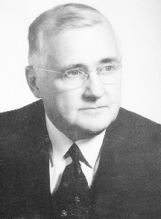
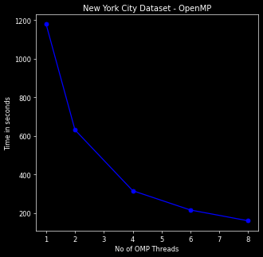
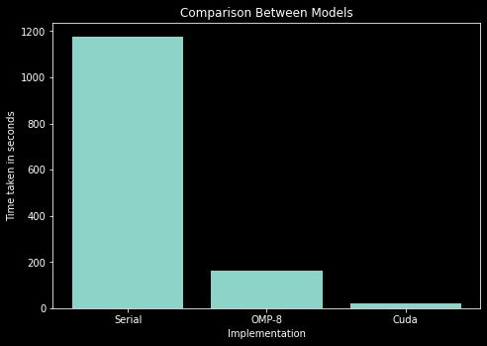
Bellman-Ford Algorithm
Algorithm 02
Slower than Dijkstra’s algo, but faster than Floyd-Warshall algo O(VE)
Can detect and report negative cycles
Not greedy: Processes all edges
Not highly parallelizable: key loop is Sequential
Speed up: achievable by non-sequential operations on edges
Running on a GPU/CUDA → significant speed up
OpenMP also gives speed up by dividing the edges across different cores
Speed up: 1.86, 3.72, 5.44, 7.33 for 2, 4, 6, 8 threads
Notes:
ATHUL
We already saw that Dijkstra’s algorithm runs on O((V+E)logV). So why should we care about a slower algorithm !!!
The ability to work with negative weights is one of the biggest advantages of this algorithm. It can also find and report negative cycles.
Why do you think we need negative edge weights when distances are always positive???
Negative weights are useful in many applications like computer games where your health, xP can increase or decrease based on the path you are taking.
Detecting negative weight cycles is also helpful because some other algorithms from getting stuck in a loop.
So despite being slower than Dijkstra’s, this property has helped it remain relevant for small to medium sized graphs.
Bellman ford is simpler compared to Dijkstra’s Algorithm, which is a greedy algorithm which stores objects in a priority queue. Bellman ford relaxes all edges and the sequence of relaxation within a particular step doesn’t matter. After V-1 iterations, all solutions, will converge to the same solution
As seen in the plots, OpenMP provided good speed up compared to the serial version using 8 threads. CUDA provided significant speed up (63)in the edge relaxation step.

Slide 7
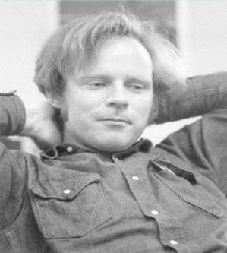
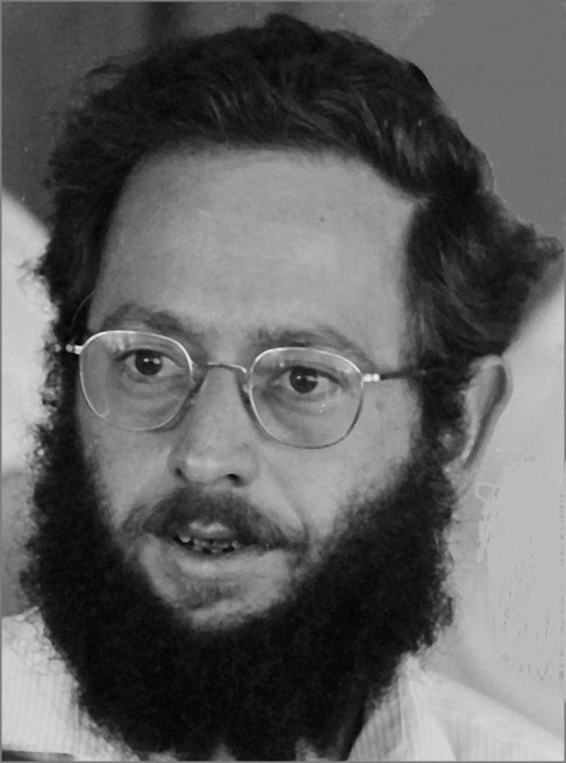
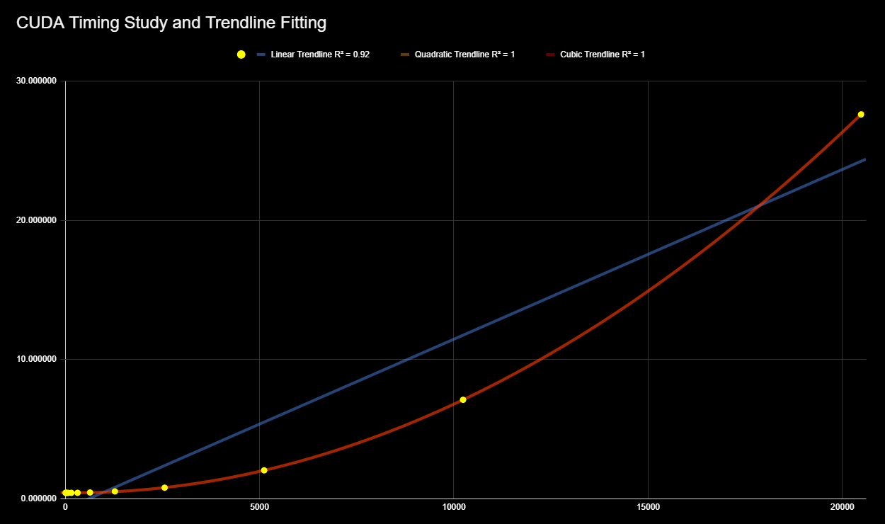
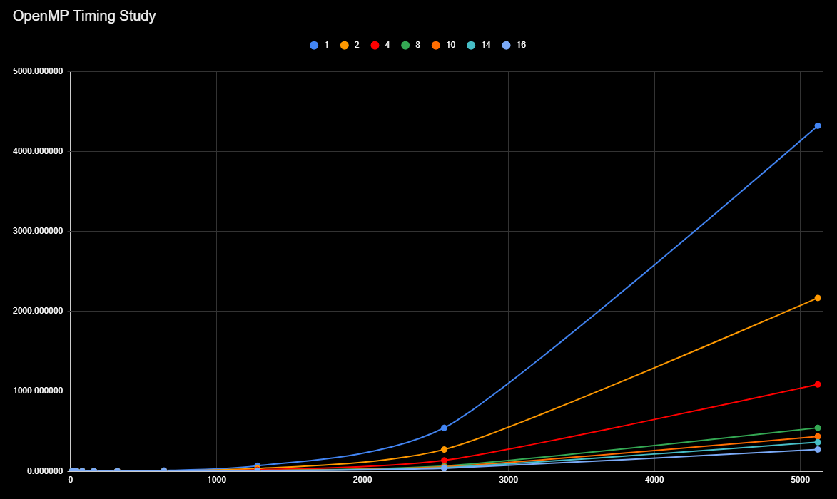
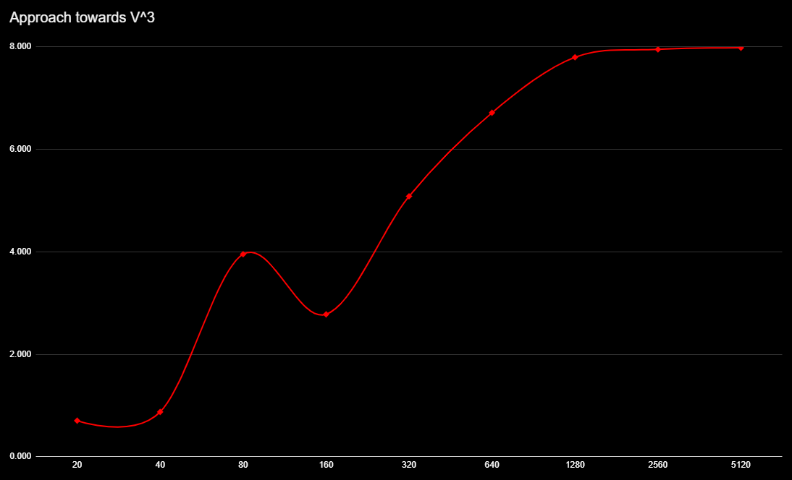
Floyd-Warshall Algorithm
Algorithm 03
Single execution → Shortest path lengths between all vertex pairs
Worst time complexity O(V³)
Usefulness:
Small dense graphs
All-pairs minimum distance
R² for CUDA
k | R² | Adj. R²
Linear | 0.918447 | 0.908253
Quadratic | 0.999986 | 0.999982
Cubic | 0.999988 | 0.999983
R² for OpenMP (numThreads = 8)
k | R² | Adj. R²
Linear | 0.847018 | 0.827895
Quadratic | 0.997321 | 0.996555
Cubic | 0.999999 | 0.999998
Notes:
AARON
Now we come to the third algorithm, the Floyd-Warshall algorithm. It performs with the worst time complexity of the three algorithms at an order of V cubed hence being useful only for small dense graphs. Due to the subsequent overflow in data, running the algorithm on the New York database was impossible. Hence, we ran it on randomly generated graphs up to a size of 5120 vertices for OpenMP and 20480 vertices for CUDA.
The top right graph represents the timing study for CUDA and we have included the linear, quadratic and cubic trendlines of the data. As is visible, the implementation tends to be quadratic. On the other hand, the OpenMP implementation tends to be more cubic since it behaves more or less like the serial algorithm. The R squared value for quadratic regression was much farther than in the case of CUDA whereas the cubic regression was even better than the CUDA one. Speaking of the effectiveness of parallelization, running OpenMP over 16 threads made the cost faster by about 15.88 times, and running CUDA made it faster by about 2100 times.
Now the plot on the left represents a behavior that we never expected. At first, for smaller number of vertices, the increase in time wasn’t proportional to V cubed. However, as we moved to larger graphs, the algorithm tended to be more and more cubic with respect to time complexity and we notice that the graph almost flattens at a factor of 8 on the y-axis for a factor of 2 on the x-axis.
// Although our code could not be tested for real-life values, this is a clear indication that our algorithm is functioning properly.

Slide 8
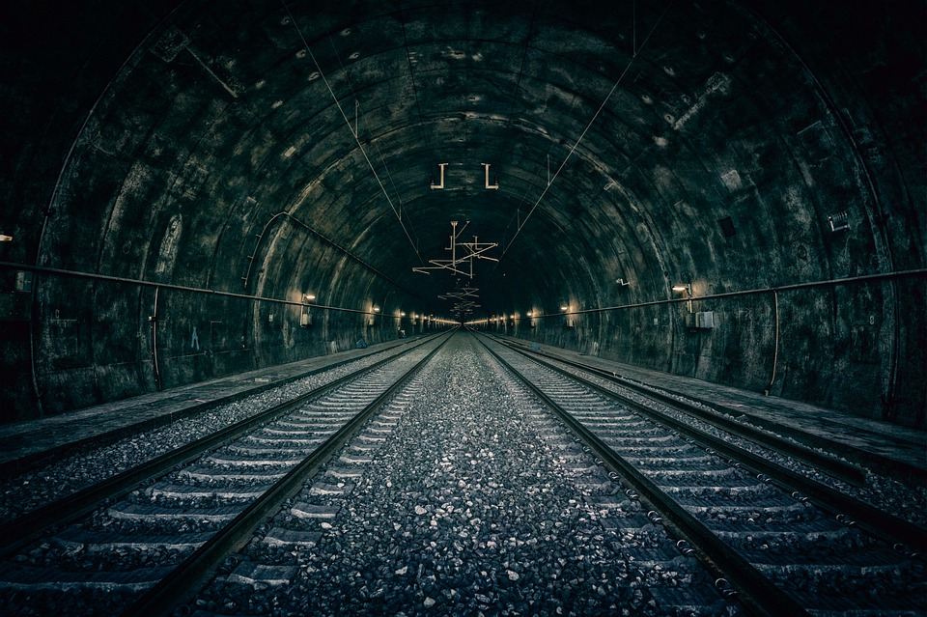
A Comparison of the Algorithms
 | Dijkstra’s | Bellman-Ford | Floyd-Warshall
Time Complexity | O((V+E)log(V)) | O(VE) | O(V³)
Can Negative Cycles ? | No | Yes | Yes
Suitable for : | Large/Medium | Medium/Small | Small
For NY Dataset: | Running time: 3sec | Running time: 1178s | Running time: ∞
Speed Up (8 threads): | 6.89 | 7.33 | 7.965
Notes:
VAIBHAV
A through-out comparison was made between all the major three graph based path planning algorithms. The most efficient and usable algorithm was the Dijkstra’s algorithm with least time complexity.
Taking about implementing on NY dataset, the fastest algorithm was the Dijkstra’s with 3sec and slowest was the Floyd Warshall with infinite time.
But if we talk about the parallel Speed up as compared to serial one, we can say the Floyd Warshall being the most slowest one, has the maximum capability in parallelization. On the other hand the fastest algorithm being Dijkstra’s has the least parallelization capability

Slide 9

Future Prospects
References
More algorithms : A* RRT D* Delta stepping
More Versatile Platforms : OpenCL MPI
Multi-Agent Path Planning + Road Constraints
Parallelization + Proper Hardware = Real-time Path Generation
Tang et al., A Parallel Shortest Path Algorithm Based on Graph-Partitioning and Iterative Correcting, IEEE HPSC
Crauser et al., A Parallelization of Dijkstra's Shortest Path Algorithm
Li et al., Multi-Agent Path Finding for Large Agents
Hong et al., Efficient Parallel Graph Exploration on Multi-Core CPU and GPU
Agarwal et al., New Approach of Bellman Ford Algorithm on GPU using Compute Unified Design Architecture (CUDA)
https://people.sc.fsu.edu/~jburkardt/c_src/dijkstra_openmp/dijkstra_openmp.html
Notes:
AARON
So, what’s next? Given here are some of the future prospects of our projects and to the right are some of the references we have used for our project. We intend to share an extensive list in our report.
// Despite the work we have done on the implementation of multiple algorithms using parallel computing, more work can be done with regard to the implementation of more diverse algorithms such as the A-star algorithm, rapidly-exploring random trees, and the D-star algorithm. Secondly, as per requirement, these algorithms may be implemented in more versatile parallel computing platforms such as OpenCL or MPI. This is really helpful for the third future prospect, that is, the implementation of path planning algorithms for multiple agents instead of a single one. Finally, parallelization implemented with proper hardware usage can provide real time path required for various applications.

Slide 10

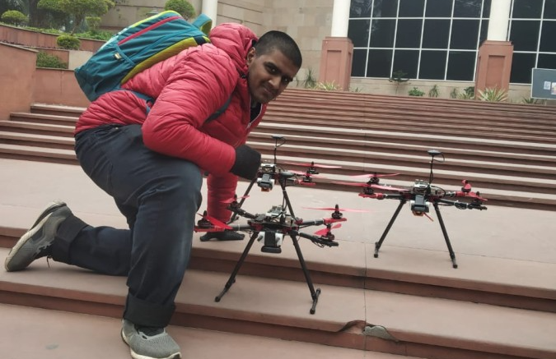
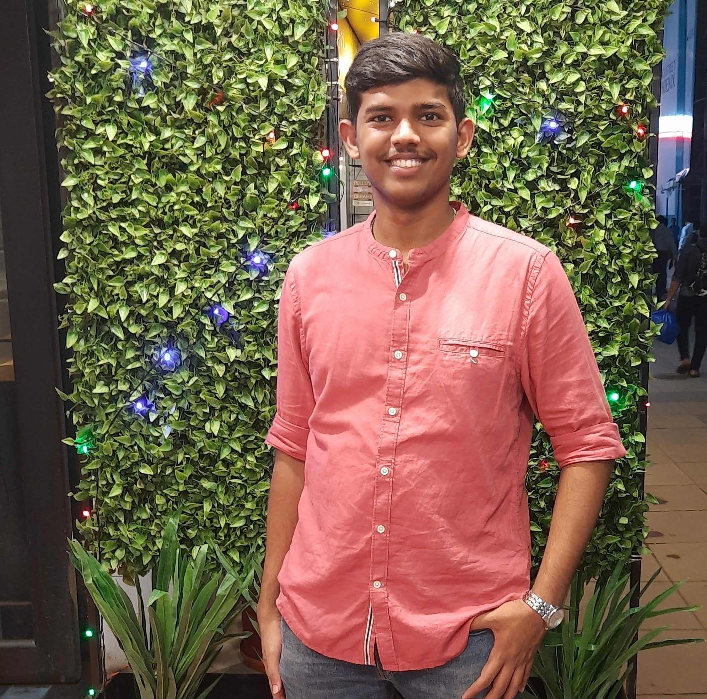


Who did what?
AARON
Bellman-Ford Algorithm - Serial, OpenMP, CUDA
Data Analysis
ATHUL
Floyd-Warshall Algorithm - Serial, OpenMP, CUDA
Test Cases
Presentation
Report
Code Base
Dijkstra’s Algorithm - Serial, OpenMP
VAIBHAV
AYAN
Notes:
AARON
Moving on to the contributions of our team, we’d say that we had different roles throughout the project which unfortunately cannot be quantified. However, here’s a diagram about the split of work.

Slide 11

Notes:
AARON
With this, we come to the end of our presentation. We’re extremely thankful towards Professor Gopalakrishnan for this opportunity and we also thank the rest of the audience here. We particularly thank the professor for the CDAC facility that proved extremely useful throughout the course and especially for the OpenMP implementations in this project.
We may now take up questions.

